Slide 1
Project Manager’s Dream Monthly Report Infographics
Here is where this template begins

Slide 2
Project Manager’s Dream Monthly Report Infographics
Today
vs
Tomorrow
Problem
Solution
1
Earth is the third planet from the Sun
Mercury is the closest object to the Sun
4
Strategy
Progress
2
Neptune is the farthest planet from the Sun
Despite being red, Mars is a cold place
5
Risk
Rewards
3
Saturn is composed of hydrogen and helium
Jupiter is a gas giant and the biggest planet
6

Slide 3
Project Manager’s Dream Monthly Report Infographics
Transition
150,000
01
Jupiter is a gas giant and the biggest planet
Goal
85,540
02
Earth is the third planet from the Sun
Free services
40,650
03
Planet Mercury is the closest object to the Sun
Paid services
9,750
04
Saturn is composed of hydrogen and helium

Slide 4
Project Manager’s Dream Monthly Report Infographics
10%
60%
25%
90%
Initiating
Planning
Executing
Monitoring
Mercury is the closest object to the Sun
Saturn is composed of hydrogen and helium
Neptune is the farthest planet from the Sun
Earth is the third planet from the Sun

Slide 5
Project Manager’s Dream Monthly Report Infographics
1
2
Inputs
Aspirations
Mercury is the closest planet to the Sun
It is composed of hydrogen and helium
3
4
Expectations
Tactics
Jupiter is the biggest object in the Solar System
Despite being red, Mars is a very cold place

Slide 6
Project Manager’s Dream Monthly Report Infographics
50%
65%
75%
30%
Initiating
Planning
Executing
Monitoring
Mercury is the closest object to the Sun
Saturn is composed of hydrogen and helium
Neptune is the farthest planet from the Sun
Earth is the third planet from the Sun

Slide 7
Project Manager’s Dream Monthly Report Infographics
40%
Problem
Jupiter is a gas giant and the biggest planet
45%
Risk
Neptune is the farthest planet from the Sun
20%
Solution
Saturn is composed of hydrogen and helium
30%
Progress
Planet Mercury is the closest object to the Sun

Slide 8
Project Manager’s Dream Monthly Report Infographics
45,840
70,600
24,300
85,000
Initiating
Risk
Executing
Monitoring
It’s the closest planet to the Sun and the smallest one
It’s a gas giant and the biggest object in the Solar System
Planet Saturn is composed of hydrogen and helium
Despite being red, Planet Mars is a very cold place

Slide 9
Project Manager’s Dream Monthly Report Infographics
10%
25%
Problem
Risk
Mercury is the closest planet to the Sun and the smallest one
It is the ringed planet. It is composed of hydrogen and helium
40%
25%
Monitoring
Rewards
Jupiter is a gas giant and the biggest object in the Solar System
Despite being red, planet Mars is actually a very cold place

Slide 10
Project Manager’s Dream Monthly Report Infographics
01
02
03
Strategy
Progress
Rewards
It’s a gas giant and the biggest object in the Solar System
Planet Saturn is composed of hydrogen and helium
It’s the closest planet to the Sun and the smallest one

Slide 11
Project Manager’s Dream Monthly Report Infographics
Solution
10%
Jupiter is a gas giant and the biggest planet
Strategy
80%
Neptune is the farthest planet from the Sun
Risk
50%
Saturn is composed of hydrogen and helium
Rewards
70%
Mercury is the closest object to the Sun
Notes:
r

Slide 12
Project Manager’s Dream Monthly Report Infographics
250
740
Paid services
Solution
It’s a gas giant and the biggest object in the Solar System
Despite being red, Mars is actually a very cold place
Free services
Problem
Saturn is composed of hydrogen and helium
It’s the closest planet to the Sun and the smallest one
350
970

Slide 13
Project Manager’s Dream Monthly Report Infographics
01
02
03
04
Strategy
Solution
Transition
Rewards
Neptune is the farthest planet from the Sun
Earth is the third planet from the Sun
Planet Mercury is the closest object to the Sun
Despite being red, Mars is a cold place

Slide 14
Project Manager’s Dream Monthly Report Infographics
55%
60%
Free services
Transition
It’s the closest planet to the Sun and the smallest one
Saturn is composed of hydrogen and helium
70%
80%
Paid services
Rewards
It’s a gas giant and the biggest object in the Solar System
Despite being red, Mars is a very cold place

Slide 15
Project Manager’s Dream Monthly Report Infographics
Strategy
250
Jupiter is a gas giant and the biggest planet
Progress
890
Earth is the third planet from the Sun
Transition
680
Mercury is the closest object to the Sun
Risk
100
Saturn is composed of hydrogen and helium

Slide 16
Project Manager’s Dream Monthly Report Infographics
Problem
60%
Jupiter is a gas giant and the biggest planet
Progress
40%
Earth is the third planet from the Sun
Rewards
30%
Mercury is the closest object to the Sun
Strategy
70%
Saturn is composed of hydrogen and helium

Slide 17
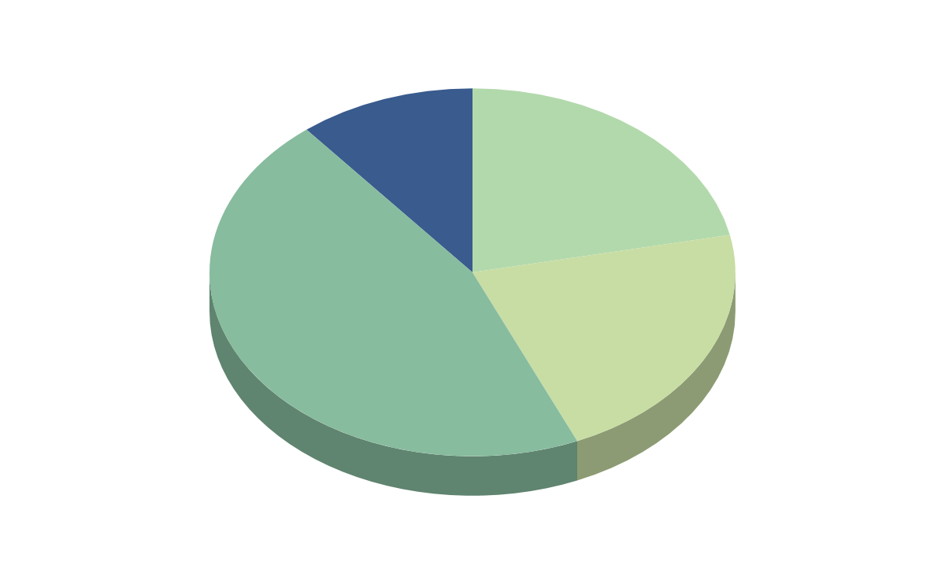
Project Manager’s Dream Monthly Report Infographics
21%
10%
Solution
Risk
Neptune is the farthest planet from the Sun
Jupiter is a gas giant and the biggest planet
21%
48%
Problem
Goal
Earth is the third planet from the Sun
Mercury is the closest object to the Sun

Slide 18
Project Manager’s Dream Monthly Report Infographics
50%
90%
35%
Paid services
Strategy
Goal
Despite being red, Mars is actually a very cold place
It’s a gas giant and the biggest object in the Solar System
It’s the closest planet to the Sun and the smallest one

Slide 19
Project Manager’s Dream Monthly Report Infographics
Solution
Progress
Despite being red, Mars is actually a very cold place
Saturn is composed mostly of hydrogen and also helium
Paid services
Strategy
It’s a gas giant and the biggest object in the Solar System
It’s the closest planet to the Sun and the smallest one

Slide 20
Project Manager’s Dream Monthly Report Infographics
40%
25%
Problem
Solution
Despite being red, Mars is a very cold place
It is composed of hydrogen and helium
25%
10%
Risk
Progress
It is the biggest object in the Solar System
Mercury is the closest planet to the Sun

Slide 21
Project Manager’s Dream Monthly Report Infographics
Transition
Strategy
A
20%
C
Earth is the third planet from the Sun
Mercury is the closest object to the Sun
40%
Goal
70%
Risk
B
Neptune is the farthest planet from the Sun
Despite being red, Mars is a cold place
D
90%

Slide 22
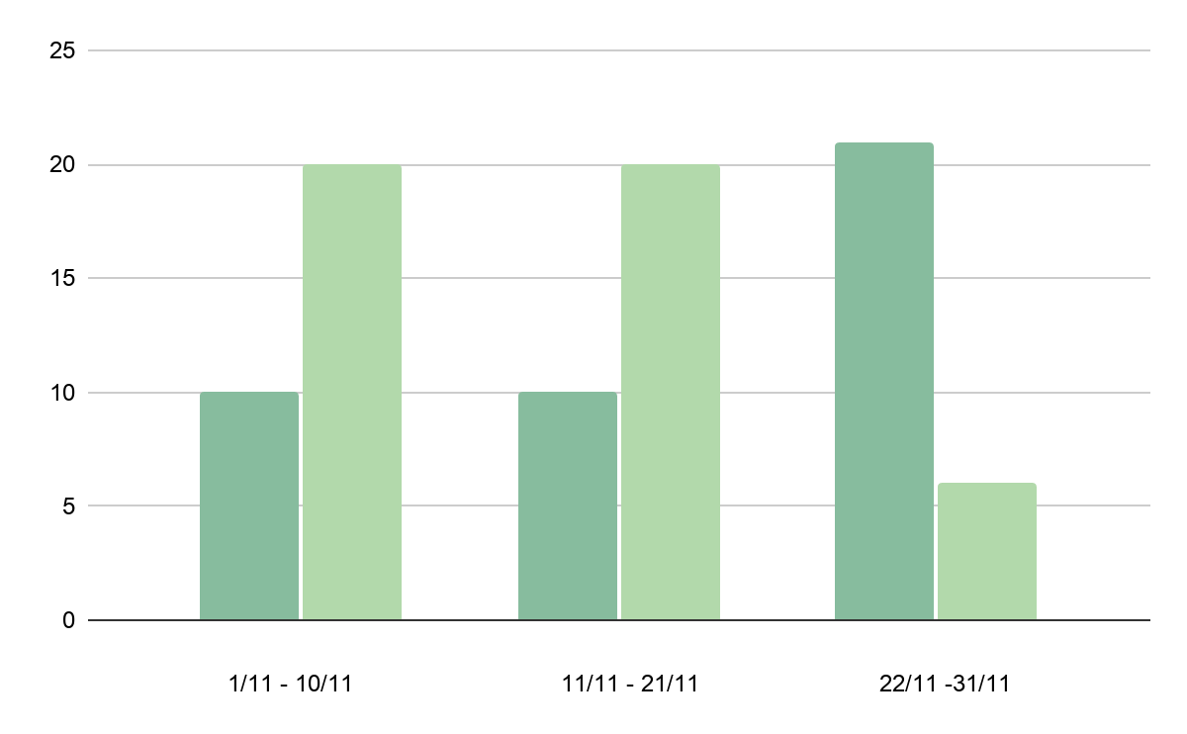
Project Manager’s Dream Monthly Report Infographics
Free services
10,250
Despite being red, Mars is actually a very cold place
Paid services
12,740
It’s a gas giant and the biggest object in the Solar System

Slide 23
Project Manager’s Dream Monthly Report Infographics
25%
10%
80%
50%
Problem
Strategy
Progress
Solution
It’s the third planet from the Sun
Earth is the third planet from the Sun
It’s a gas giant and the biggest planet
It’s composed of hydrogen and helium

Slide 24
Project Manager’s Dream Monthly Report Infographics
A
C
Goal
Free services
Despite being red, Mars is a very cold place
It is composed of hydrogen and helium
B
D
Progress
Rewards
It is the biggest object in the Solar System
Mercury is the closest planet to the Sun

Slide 25
Project Manager’s Dream Monthly Report Infographics
35%
60%
75%
90%
Progress
Paid services
Strategy
Goal
Despite being red, Mars is actually a very cold place
It is the ringed planet. It is composed of hydrogen and helium
Jupiter is a gas giant and the biggest object in the Solar System
Mercury is the closest planet to the Sun and the smallest one

Slide 26
Project Manager’s Dream Monthly Report Infographics
Transition
60%
Jupiter is a gas giant and the biggest planet
Progress
40%
Earth is the third planet from the Sun
Paid services
30%
Mercury is the closest object to the Sun
Rewards
70%
Saturn is composed of hydrogen and helium

Slide 27
Project Manager’s Dream Monthly Report Infographics
Problem
Strategy
Progress
Solution
It’s the third planet from the Sun
Earth is the third planet from the Sun
It’s a gas giant and the biggest planet
It’s composed of hydrogen and helium

Slide 28
Project Manager’s Dream Monthly Report Infographics
25,000€
40,000€
Goal
Progress
Despite being red, Mars is a very cold place
It is composed of hydrogen and helium
50,000€
60,000€
Solution
Transition
It is the biggest object in the Solar System
Mercury is the closest planet to the Sun

Slide 29
Project Manager’s Dream Monthly Report Infographics
48%
10%
Paid services
Strategy
Mars is actually a very cold place
It is composed of hydrogen and helium
75%
65%
Risk
Solution
It’s the biggest object in the Solar System
It’s the closest planet to the Sun

Slide 30
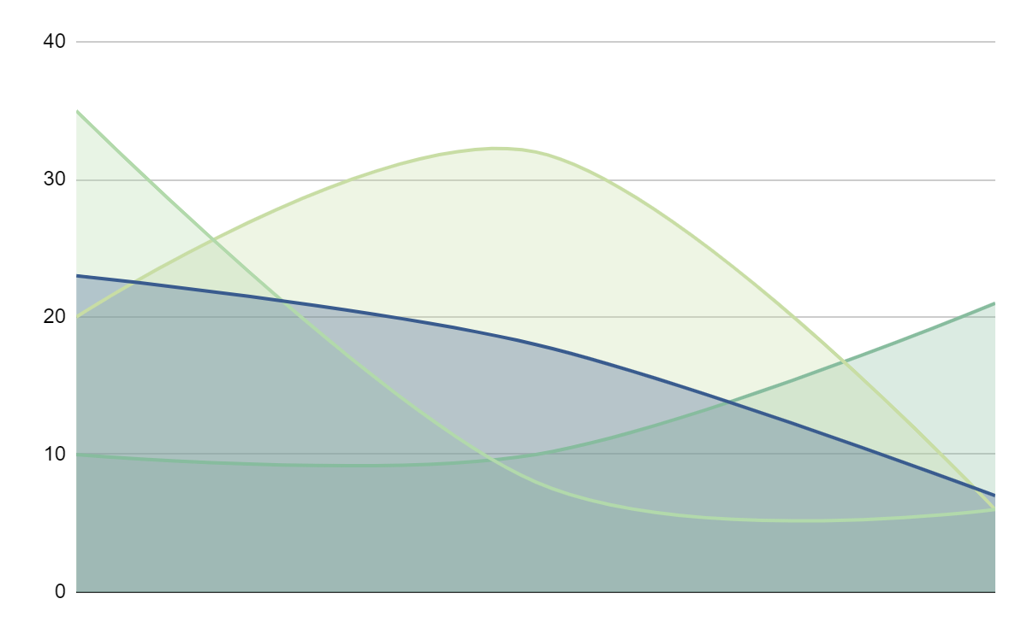
Project Manager’s Dream Monthly Report Infographics
80%
75%
Goal
Strategy
Despite being red, Mars is a very cold place
It is composed of hydrogen and helium
35%
65%
Transition
Risk
It is the biggest object in the Solar System
Mercury is the closest planet to the Sun

Slide 31
Project Manager’s Dream Monthly Report Infographics
35%
75%
80%
Rewards
Free services
Problem
It is the biggest object in the Solar System
It is composed of hydrogen and helium
Despite being red, Mars is a very cold place

Slide 32
Instructions for use (free users)
In order to use this template, you must credit Slidesgo by keeping the Thanks slide.
You are allowed to:
Modify this template.
Use it for both personal and commercial purposes.
You are not allowed to:
Sublicense, sell or rent any of Slidesgo Content (or a modified version of Slidesgo Content).
Distribute this Slidesgo Template (or a modified version of this Slidesgo Template) or include it in a database or in any other product or service that offers downloadable images, icons or presentations that may be subject to distribution or resale.
Use any of the elements that are part of this Slidesgo Template in an isolated and separated way from this Template.
Delete the “Thanks” or “Credits” slide.
Register any of the elements that are part of this template as a trademark or logo, or register it as a work in an intellectual property registry or similar.
For more information about editing slides, please read our FAQs or visit Slidesgo School:
https://slidesgo.com/faqs and https://slidesgo.com/slidesgo-school

Slide 33
Instructions for use (premium users)
In order to use this template, you must be a Premium user on Slidesgo.
You are allowed to:
Modify this template.
Use it for both personal and commercial purposes.
Hide or delete the “Thanks” slide and the mention to Slidesgo in the credits.
Share this template in an editable format with people who are not part of your team.
You are not allowed to:
Sublicense, sell or rent this Slidesgo Template (or a modified version of this Slidesgo Template).
Distribute this Slidesgo Template (or a modified version of this Slidesgo Template) or include it in a database or in any other product or service that offers downloadable images, icons or presentations that may be subject to distribution or resale.
Use any of the elements that are part of this Slidesgo Template in an isolated and separated way from this Template.
Register any of the elements that are part of this template as a trademark or logo, or register it as a work in an intellectual property registry or similar.
For more information about editing slides, please read our FAQs or visit Slidesgo School:
https://slidesgo.com/faqs and https://slidesgo.com/slidesgo-school

Slide 34
Infographics
You can add and edit some infographics to your presentation to present your data in a visual way.
Choose your favourite infographic and insert it in your presentation using Ctrl C + Ctrl V or Cmd C + Cmd V in Mac.
Select one of the parts and ungroup it by right-clicking and choosing “Ungroup”.
Change the color by clicking on the paint bucket.
Then resize the element by clicking and dragging one of the square-shaped points of its bounding box (the cursor should look like a double-headed arrow). Remember to hold Shift while dragging to keep the proportions.
Group the elements again by selecting them, right-clicking and choosing “Group”.
Repeat the steps above with the other parts and when you’re done editing, copy the end result and paste it into your presentation.
Remember to choose the “Keep source formatting” option so that it keeps the design. For more info, please visit Slidesgo School.

